Slide 1
3. Robot Control
3.1 Fundamentals
3.2 Single-joint Control
3.3 Computed Torque Control
3.3 Lyapunov Stability Analysis
3.5 Adaptive Control
- 0 -

Slide 2
3.3.2 Lyapunov Stability Analysis
Lyapunov Stability Analysis or Lyapunov's second (or direct) method after a Russian mathematician of the 19th century is concerned with determining the stability of a differential equation.
without solving for the solution of the differential equation governing the system.
It generally does not provide any information about the transient response or performance of the system.
Lyapunov Stability Analysis
How can you use the results to design stable control?
- 1 -

Slide 3
3.3.2 Lyapunov Stability Analysis
To prove a system stable by Lyapunov's method, one is required to propose a generalized "energy" function V(x) that has the following properties:
V(x) has continuous first partial derivative and V(x) > 0 for all x except V(0) = 0.
. Here, means the change in V(x) along system trajectories.
For detailed description, see:
J. Slotine and W. Li, Applied Nonlinear Control, Prentice Hall, Englewood Cliffs, 1991.
- 2 -

Slide 4
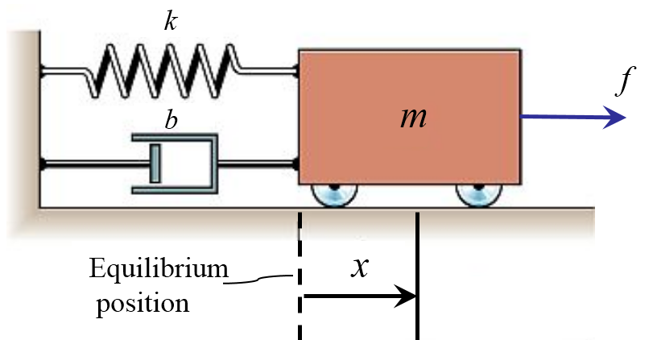
3.3.2 Lyapunov Stability Analysis
Example 3.1
Consider the simple mass-spring friction system:
In state space,
(3.3.7)
Show that the system is stable at the origin. The total energy of the system is given by
(3.3.8)
Energies = kinetic & potential energies
(3.3.9)
- 3 -

Slide 5
3.3.2 Lyapunov Stability Analysis
Substituting the dynamic equation (3.3.7) (along the trajectory of the system) into (3.3.9) yields
This means that however it is perturbed, the system will lose energy until it comes to rest .
At steady state, we have kx=0 from (3.3.7), or x=0.
(3.3.10)
The system is stable.
- 4 -

Slide 6
3.3.2 Lyapunov Stability Analysis
Example 3.2
Consider a manipulator described by
and controlled with the control law
with .
This control scheme does not force the manipulator to follow a trajectory, but moves the manipulator to a goal position.
The resulting closed-loop equation is
and it can be proven globally asymptotically stable.
(3.3.11)
(3.3.12)
(3.3.13)
- 5 -

Slide 7
3.3.2 Lyapunov Stability Analysis
Proof:
Consider the Lyapunov candidate
which is always non-negative since .
Differentiating V along (3.3.13), we have
(3.3.14)
(From 3.3.13)
- 6 -

Slide 8
3.3.2 Lyapunov Stability Analysis
Therefore is nonpositive as long as is positive definite. Next let us investigate whether the system can get "strucked" with non-zero error.
Since can only remain zero along trajectories that have
we can see from equation (3.3.13) that in this case
Therefore the system is asymptotically stable.
This proof is important in that it explains, to some extent, why today's industrial robot work.
- 7 -

